Slide 1
What is Machine Learning?
Introduction to Machine Learning, Part 1

Slide 2
“Learning is any process by which a system improves performance from experience”
Herbert Simon

Slide 3

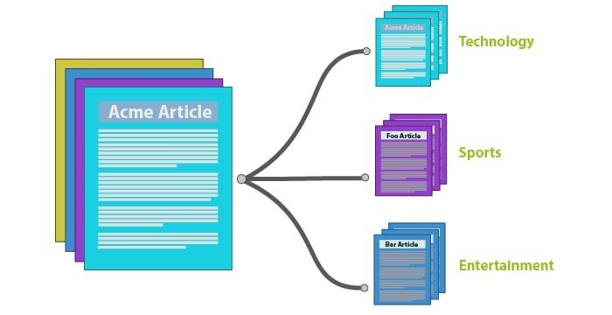
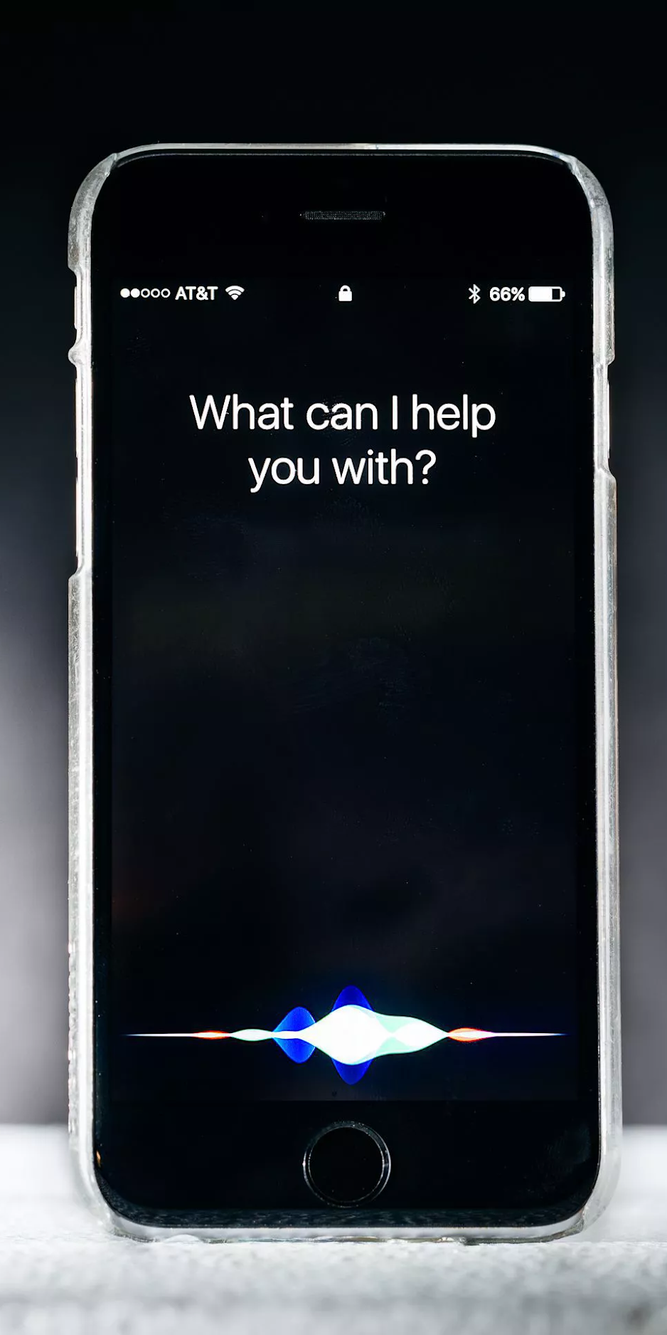
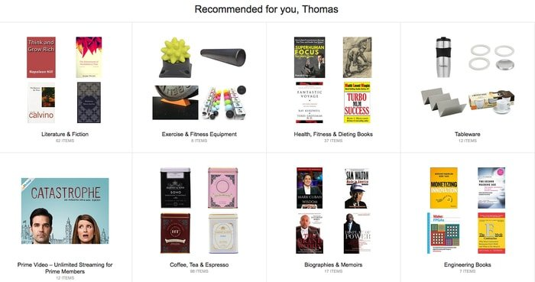
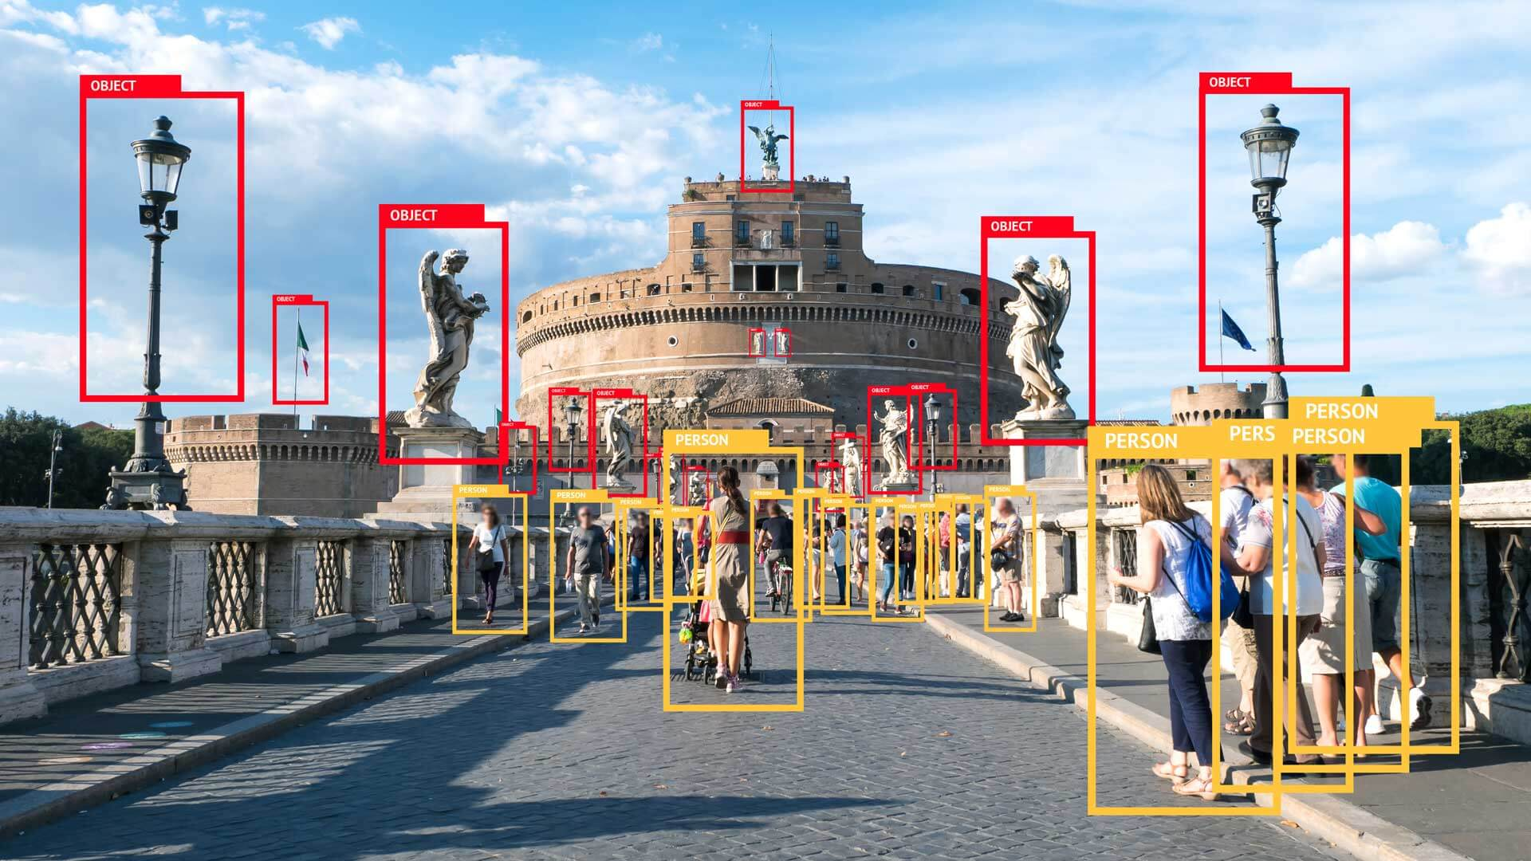
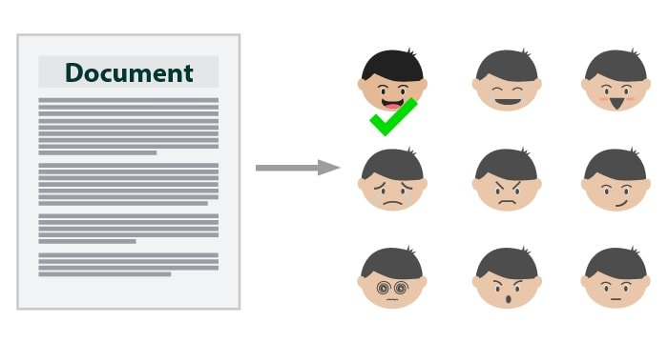
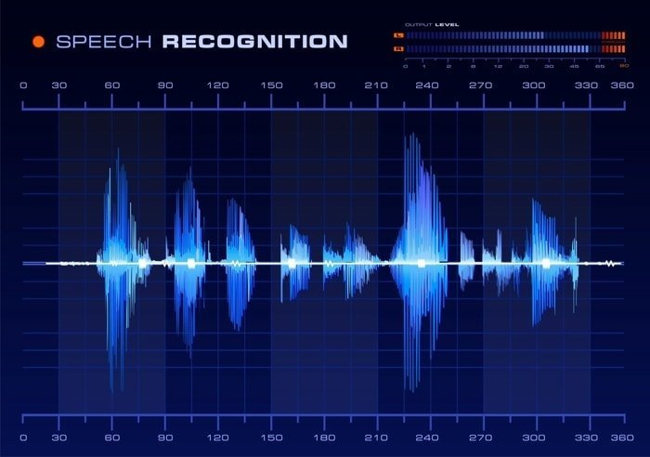
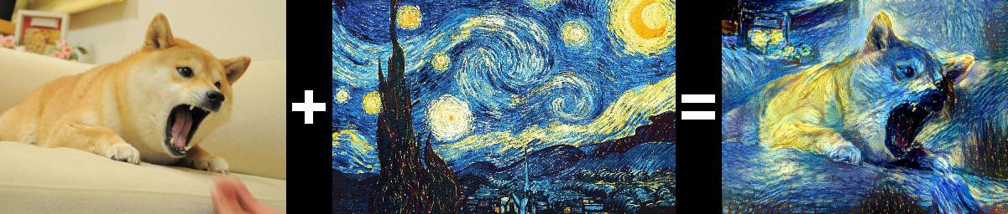

Where is ML used?
Everywhere!

Slide 4
Applications
Image Recognition
Recommender Systems
Voice Recognition
Chatbots
Emotion Detection
Stock Prediction
Robot Control
Text Classification
Sentiment Analysis
Style Transfer
...

Slide 5
Types of ML
Supervised (Our main focus):
A kind of function estimation
Unsupervised:
Cluster unlabeled data
Reinforcement:

